Slide 1
Shopping Cart Web Application
Vishal Katkar

Slide 2
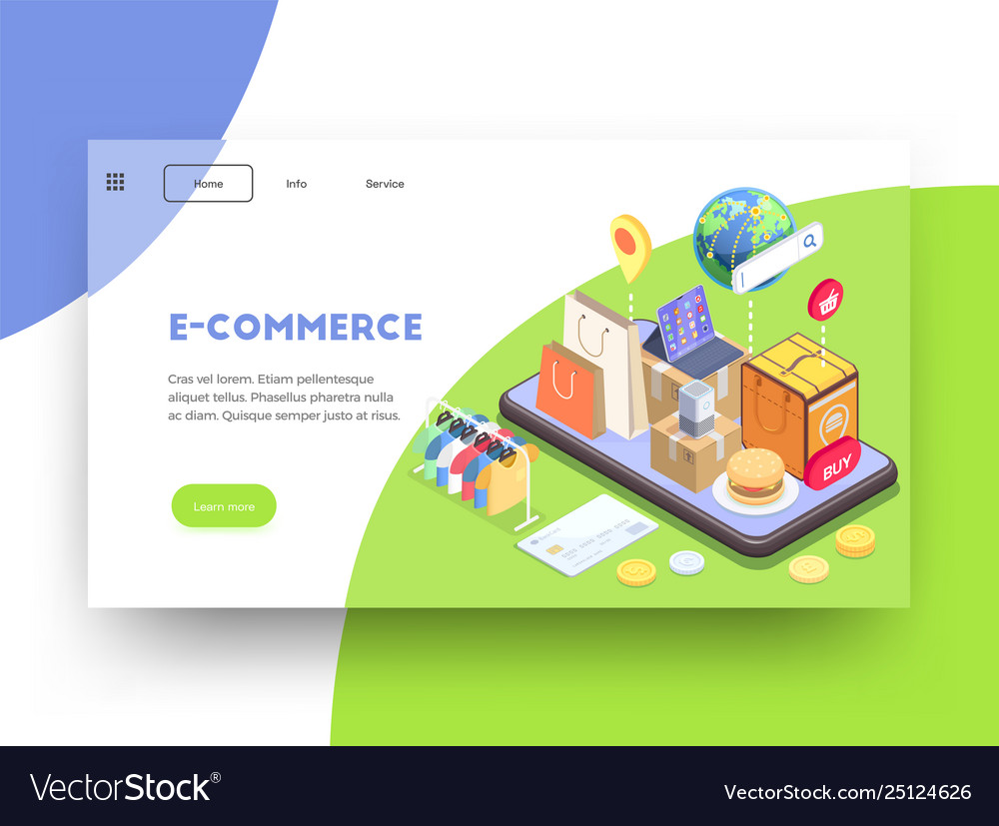
Introduction
The Shopping Cart Web Application functions as an independent platform that connects merchants and users. It integrates with databases to store product information, user data, and transaction details, ensuring a seamless interaction and efficient transaction processing.
Today, we'll be taking a deep dive into the world of online shopping and exploring the amazing features of the Shopping Cart Web Application. From its user-friendly interface to its secure login system, we'll show you how this application can revolutionize your shopping experience. So sit back, relax, and get ready to explore the future of online shopping!

Slide 3
Objective
The objective of this presentation is to provide an in-depth understanding of the Shopping Cart Web Application. We will cover the technologies used, key features, architecture, and challenges faced during development.
By the end of this presentation, you will have a clear idea of what makes the Super Mall Web Application unique and why it's worth exploring further.
Rural towns often struggle to reach a wider customer base for their commodities. the SuperMall Web Application aims to address this problem by providing a platform wheremerchants can advertise and sell their products to a global audience, expanding their reachand improving business prospects.

Slide 4

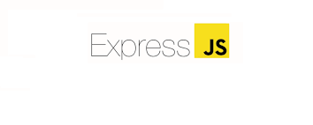
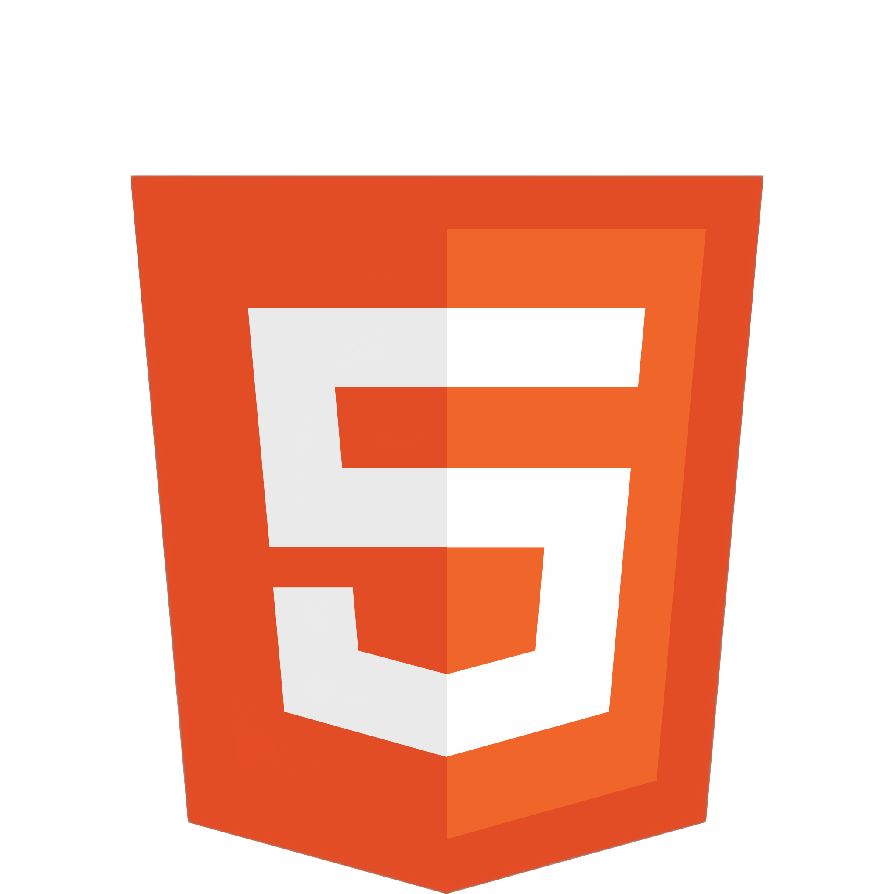
Technologies Used:
1.React.js
The React.js framework is an open-source JavaScript framework and library developed by Facebook. It’s used for building interactive user interfaces and web applications quickly and efficiently with significantly less code than you would with vanilla JavaScript.
In React, you develop your applications by creating reusable components that you can think of as independent Lego blocks. These components are individual pieces of a final interface, which, when assembled, form the application’s entire user interface.
2.HTML
The HyperText Markup Language or HTML is the standard markup language for documents designed to be displayed in a web browser. It defines the meaning and structure of web content.

Slide 5
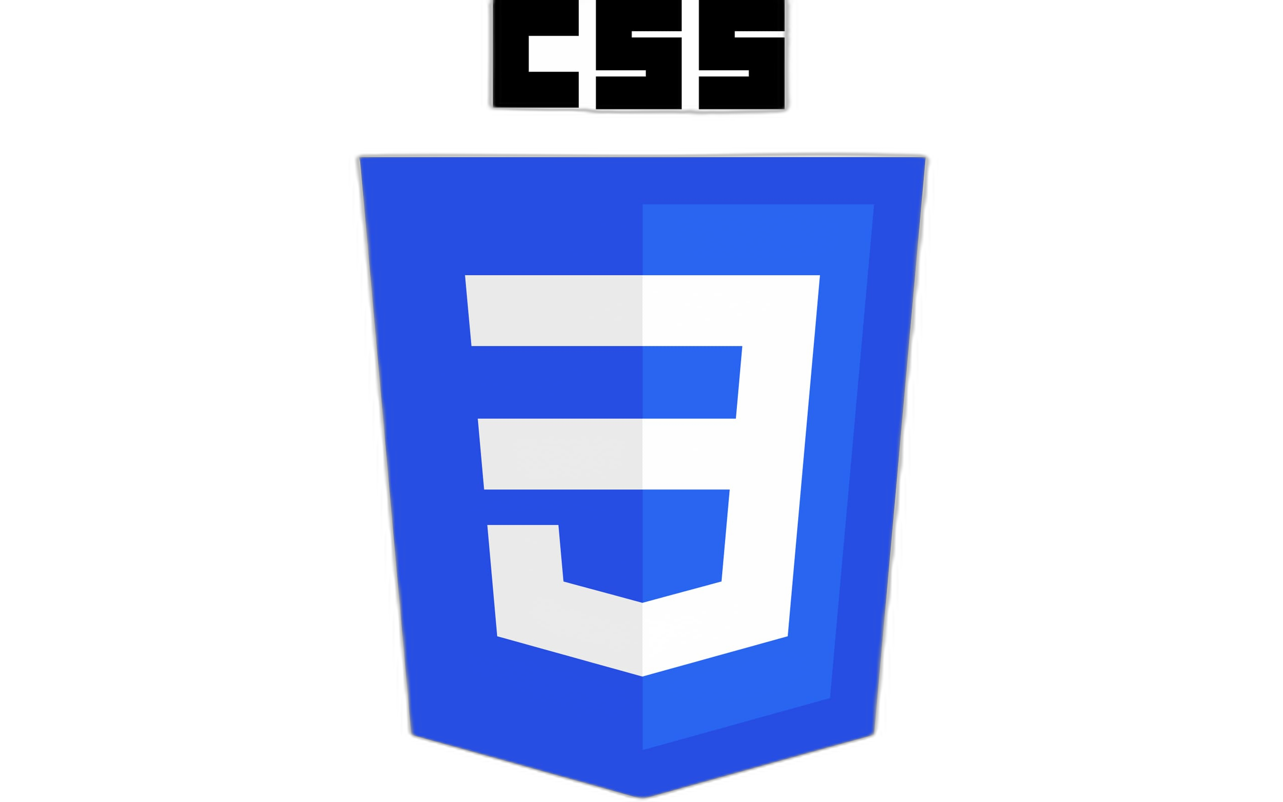

Technologies Used:
3. CSS
CSS stands for Cascading Style Sheets. It is a style sheet language which is used to describe the look and formatting of a document written in markup language. It provides an additional feature to HTML. It is generally used with HTML to change the style of web pages and user interfaces.
4.JavaScript
JavaScript is a scripting language that enables you to create dynamically updating content, control multimedia, animate images, and pretty much everything else. (Okay, not everything, but it is amazing what you can achieve with a few lines of JavaScript code.)

Slide 6

Technologies Used:
5. Redux Toolkit
Redux allows you to manage your app’s state in a single place and keep changes in your app more predictable and traceable. It makes it easier to reason about changes occurring in your app. But all of these benefits come with tradeoffs and constraints. One might feel it adds up boilerplate code, making simple things a little overwhelming; but that depends upon the architecture decisions.

Slide 7
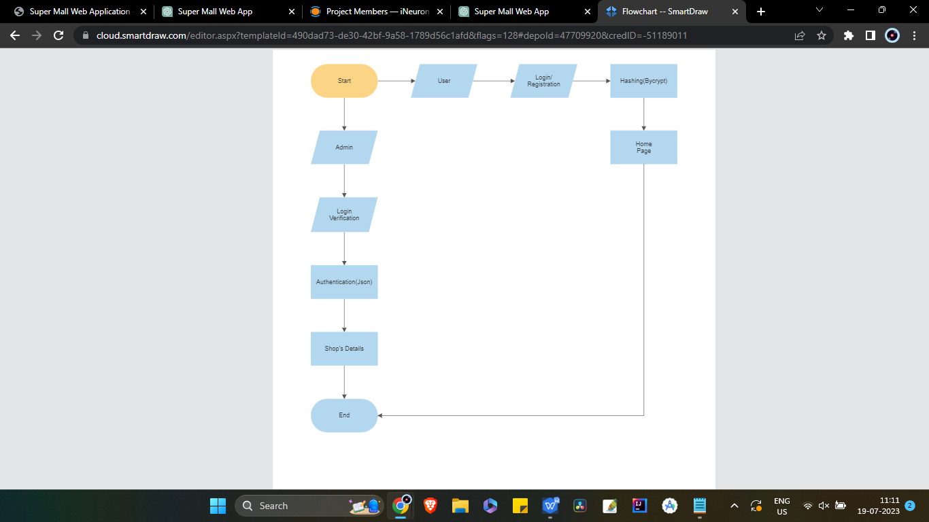
Architecture:

Slide 8
Software Requirements:
Operating System: Windows 7 & above
Coding Language: JavaScript, HTML, CSS
Framework: React.js, Redux Toolkit
IDE: Visual Studio Code
Hardware Requirements:
Processor: i3 or above
Ram: 512MB
Hard Disk: 20GB+
Processor Speed: 2ghz+

Slide 9
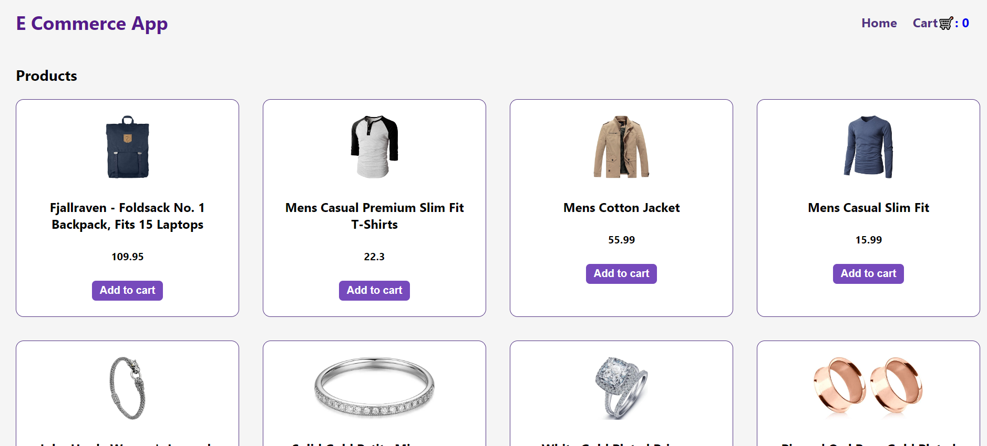

Slide 10
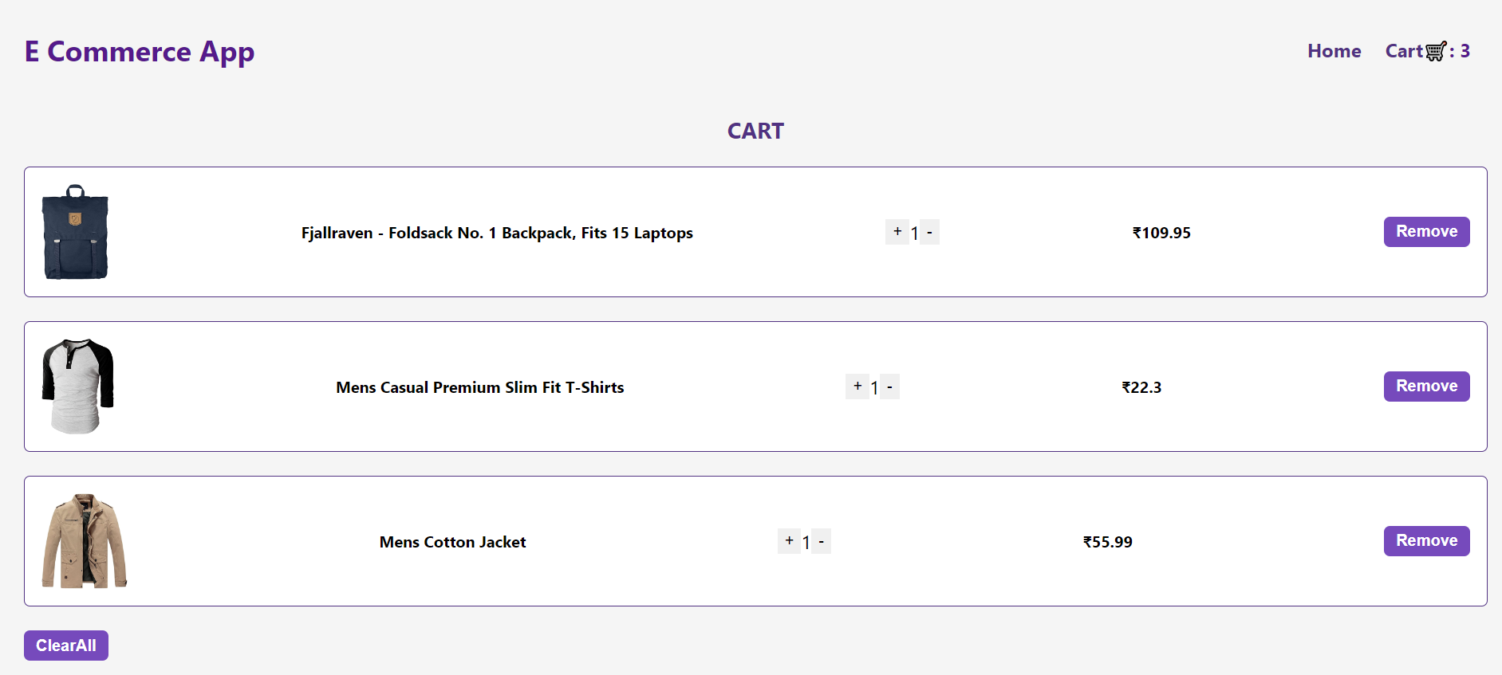

Slide 11
Conclusion
In conclusion, the Shopping Cart Web Application is a powerful tool for both shoppers and mall owners. With its user-friendly interface, fast performance, and secure login system, it provides a seamless shopping experience that is second to none.
Additionally, the application's modular design and use of RESTful APIs make it highly scalable and adaptable to meet the needs of any mall or shopping center. And with its robust security features, including bcrypt and jsonwebtoken, shoppers can rest assured that their personal information is safe and secure.
So whether you're a shopper looking for the ultimate shopping experience or a mall owner looking to take your business to the next level, the Shopping Cart Web Application is the perfect solution for you.

Slide 12
THANKS

